Slide 1

WASTE MANAGEMENT

Slide 2
1
DATASET
The dataset contains 20,000 rows and 7 columns, capturing sensor-based waste classification data. It includes attributes like sensor_id, timestamp, waste_type, and sensor readings for inductive_property, capacitive_property, moisture_property, and infrared_property. There are no missing values, and data types include integers, floats, and strings. The dataset is structured for analysis of waste types based on sensor properties, with examples such as recyclable, non-recyclable, and organic waste categories.

Slide 3
2
OVERVIEW
Introduction
Model Building
Steps
Random Forest Classifer
Data Visualization
Model details
Data Preprocessing
Comparison of models
Feature selection & transformation
Conclusion

Slide 4
3
INTRODUCTION
This project focuses on utilizing a sensor-based dataset for waste classification, containing diverse features like inductive, capacitive, moisture, and infrared properties. The workflow begins with visualizing the data to uncover patterns and insights, followed by preprocessing steps to clean and normalize the data for analysis. Advanced classification algorithms are then applied, with a particular emphasis on the Random Forest Classifier due to its robustness and accuracy in handling multidimensional data. The goal is to accurately classify waste types such as recyclable, non-recyclable, and organic, enabling smarter waste management solutions.

Slide 5
4
STEPS
1. Import Libraries
4. Data visualization
Import all required libraries like pandas, matplotlib, seaborn, and scikit-learn.
Create graphs to explore relationships between different columns.
2. Load Dataset
5. Data Preprocessing
Load the dataset from your computer using pandas.
Clean the data by removing duplicates, handling missing values, and normalizing features.
3. About Dataset
6. Model Building
Display information such as column names, data types, first five rows, and last five rows.
Train and test classification models like Random Forest and XGBoost for waste type prediction.

Slide 6
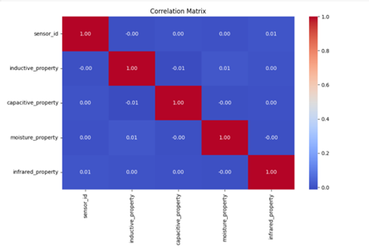
5
DATA VISUALIZATION
1
Bar chart of waste type distribution.
2
Heatmap of feature correlations.
3
Scatterplot (e.g., inductive vs. moisture property).
4
Line plot showing waste type trends over time.

Slide 7
6
DATA PREPROCESSING
1
Handling missing values (e.g., mean imputation).
2
Label encoding for categorical data.
3
Feature scaling using standardization.
4
Outlier detection and treatment.
5
Feature engineering (e.g., creating interaction terms).

Slide 8
7
FEATURE SELECTION & TRANSFORMATION
VARIANCE INFLATION FACTOR
(VIF)
PRINCIPAL COMPONENET ANALYSIS
(PCA)

Slide 9
8
MODEL BUILDING
Training and testing dataset
Model Training
Prediction
Metrics- Confusion matrix, Classification report, accuracy

Slide 10
9
RANDOM FOREST CLASSIFIER
A Random Forest classifier is an ensemble learning method that builds multiple decision trees and combines their predictions to improve accuracy and prevent overfitting. It works by randomly selecting subsets of features and training a separate decision tree on each subset. During prediction, each tree makes a vote, and the class with the majority vote is selected as the final output. Random Forest is highly effective for classification tasks, handling both numerical and categorical data well, and is robust to noise and overfitting compared to a single decision tree.

Slide 11
10
MODEL DETAILS
Ensemble Method
Hyperparameters
Combines multiple decision trees to improve accuracy and reduce overfitting.
Used 100 estimators, no maximum depth, and class balancing for optimal performance.
Feature Importance
Robustness
Identifies the most influential features, aiding interpretability of the model.
Handles noise and outliers effectively, ensuring consistent predictions.
Accuracy
Achieved the highest accuracy among all tested models, proving its effectiveness.

Slide 12
11
COMPARISON OF MODELS
Logistic Regression
Achieved moderate accuracy; limited by its linear nature, making it less effective for complex patterns in the dataset.
Support Vector Machine (SVM)
Performed well with non-linear relationships but required extensive parameter tuning.
K-Nearest Neighbors (KNN)
Struggled with high-dimensional data and larger dataset size, resulting in lower accuracy.
Decision Tree
Performed adequately but prone to overfitting due to its hierarchical structure.

Slide 13
12
COMPARISON OF MODELS
Naive Bayes
Worked well for categorical features but underperformed with continuous sensor data.
Random Forest
Best-performing model with high accuracy, leveraging feature importance and ensemble learning for robust predictions.
XGBoost
Delivered competitive accuracy but required more computational resources and hyperparameter tuning.
Highlight: Random Forest was the most effective due to its ability to handle feature interactions and robustness against noise.

Slide 14
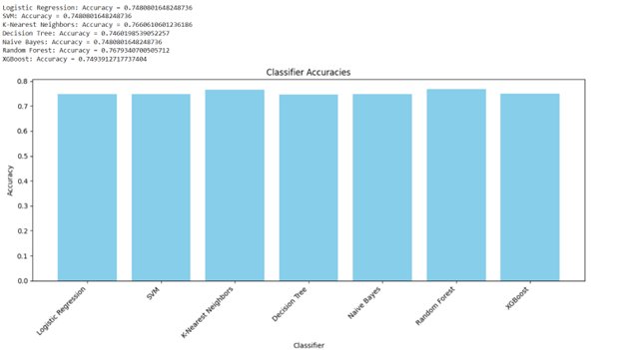
13
﻿RESULT

Slide 15
14
CONCLUSION
This project successfully classified waste types using machine learning, with the Random Forest Classifier achieving high accuracy. Effective data visualization, preprocessing, and feature engineering were key to optimizing model performance. The results showcase the potential of data-driven methods for efficient waste management and pave the way for smarter, sustainable solutions in real-world applications.

Slide 16
THANK YOU

